Slide 1

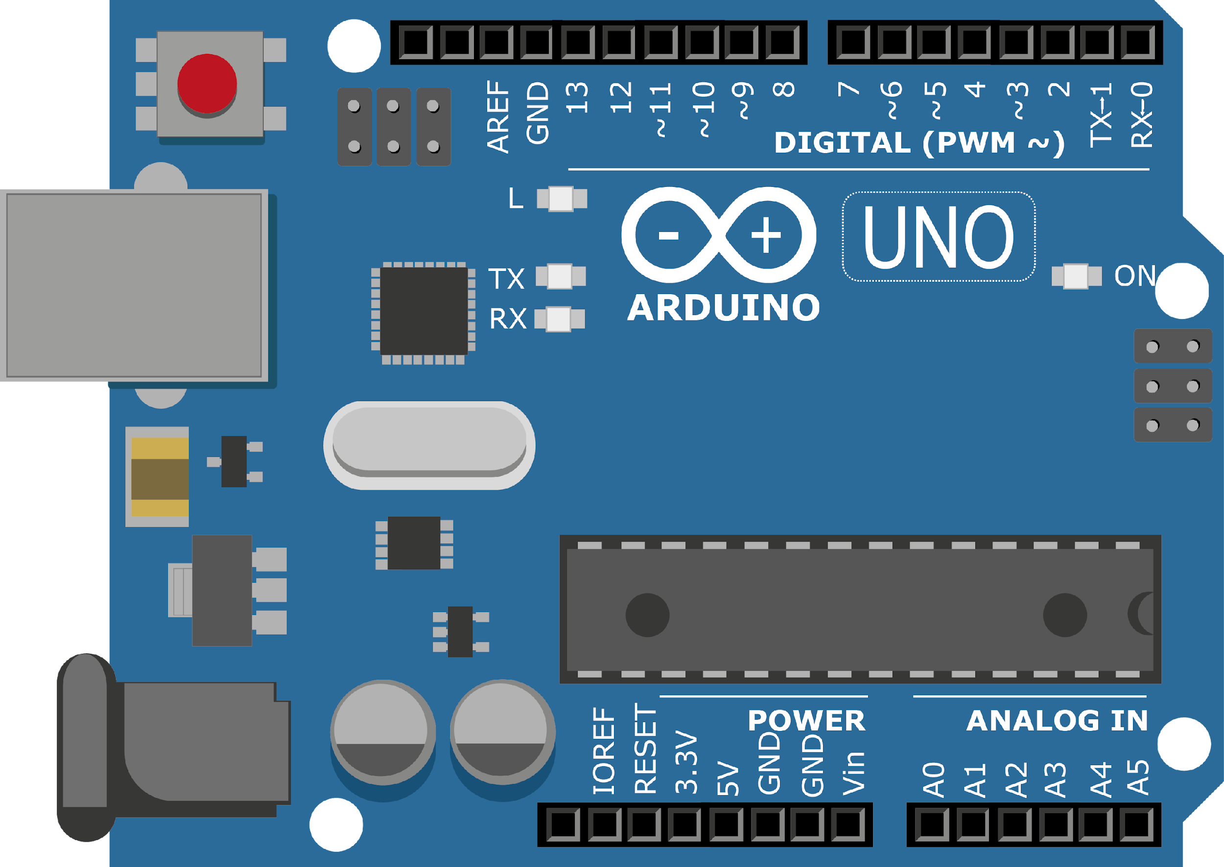
ARDUINO MASTER CLASS
24
Servo Motor | Door lock system

Slide 2
24 AGENDA
02
03
01
Interface Servo Motor
Servo Motor
Interview questions & News

Slide 3
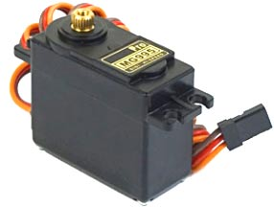

Servo Motor
It can rotate with great precision.
It consists of a control circuit that provides feedback on the current position of the motor shaft, this feedback allows the servo motors to rotate with great precision.
It is a closed-loop system where it uses a positive feedback system to control motion and the final position of the shaft. Here the device is controlled by a feedback signal generated by comparing output signal and reference input signal.
It consists of three parts:
Controlled device
Output sensor
Feedback system

Slide 4
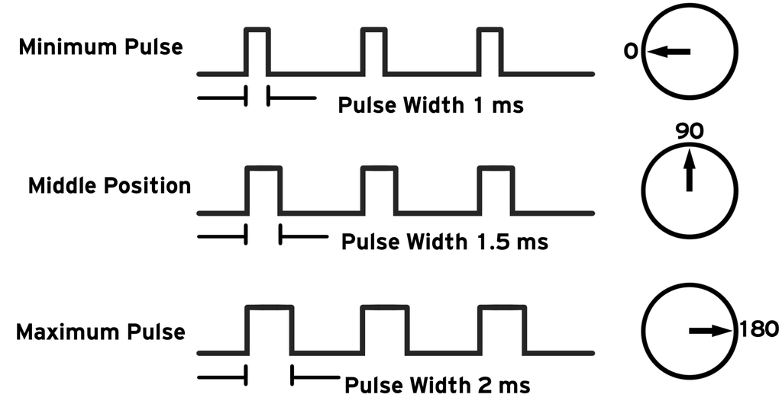
PWM

Slide 5
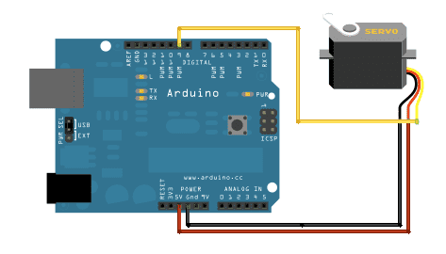
Servo motor - Arduino

Slide 6
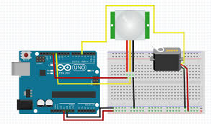
Servo motor | PIR Sensor - Arduino

Slide 7

INTERVIEW QUESTIONS
Static & Dynamic RAM
CAN
JTAG
Controller Area Network (CAN) is a serial network technology that was originally designed for the automotive industry. Embedded systems, and as its name implies, is a network technology that provides fast communication among microcontrollers up to real-time requirements, eliminating the need for the much more expensive and complex technology of a Dual-Ported RAM.
JTAG Joint Test Action Group – It is an integrated method for testing interconnects on printed circuit boards (PCBs) that are implemented at the integrated circuit (IC) level.
Processor debug/emulation | Programming FPGAs/CPLDs
Dynamic RAM has to be dynamically refreshed all of the time or it forgets what it is holding.
static RAM, a form of flip-flop holds each bit of memory (see How Boolean Gates Work for detail on flip-flops). static RAM is fast and expensive, and dynamic RAM is less expensive and slower. Therefore static RAM is used to create the CPU's speed-sensitive cache, while dynamic RAM forms the larger system RAM space.

Slide 8

THANKS!

